Slide 1
Lec 7 Forms of corrosion
Presented by
D. Rasha Afify
Assistant Professor of Mechanical Engineering
Shoubra Faculty of Engineering

Slide 3
Uniform corrosion
In such type of corrosion there is a uniform decrease in the volume of the metal due to direct contact with the surrounding environment.
Examples
Dissolvation of Zn, Al metal in acids and Pb metal in base.

Slide 4
2.Atmospheric corrosion
Atmospheric corrosion take place due to direct contact between metal and atmosphere
Types of atmosphere:
Gas type: contain mainly oxygen gas( 23% W / W) and water vapor.
Liquid type: contain mainly water and dissolved oxygen.

Slide 5
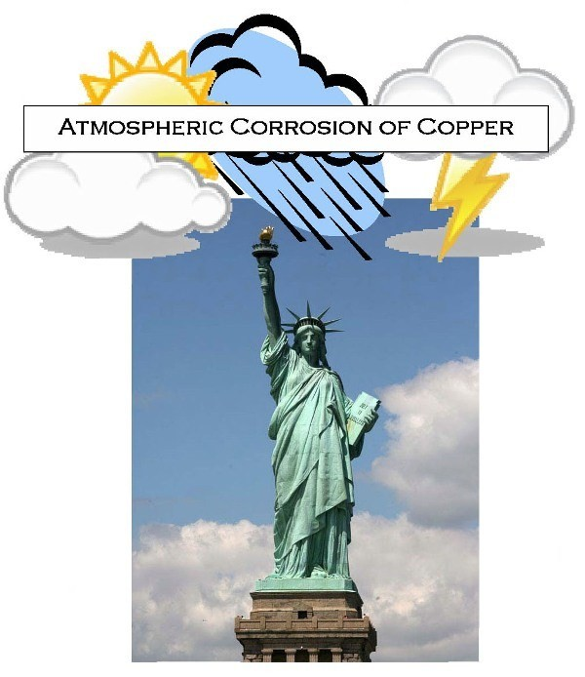
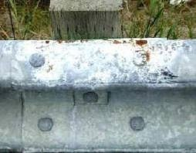

Slide 6
iron rust
Atmospheric corrosion involve formation of metal oxide layer when metal in direct contact with its surrounding environment.
Example:
Formation of iron rust due to contact with air Fe + air, H₂O Fe(OH)₂ Fe₂O₃ Fe₂O₃ .3H₂O is Iron rust (reddish brown fبني محمر ppt.)
SO2+ H2o------------ H2So4

Slide 7
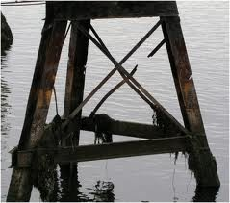
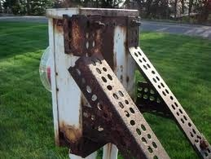

Slide 8
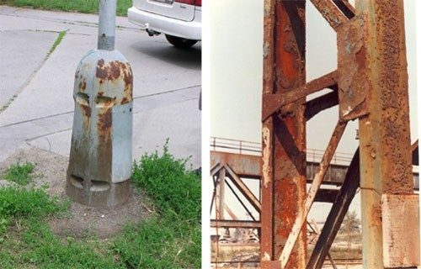

Slide 9
Oxide layers
Protective | Non Protective
Non active | active
Non porous | porous
Ex: Zn, Al, Ni | Ex: iron rust

Slide 10
Rate of atmospheric corrosion depends on
Nature of metal or alloy.
Nature of oxide layer.

Slide 11
Factors affecting atmospheric corrosion:
Type of metal or alloy
Type of atmosphere (dust, humidity, pollutant. Water vapor, gases,…)to occur humidity must be ˃60
Temperature( as T increase as rate increase)
Time: The extent of corrosion increases with increased time

Slide 12
Surface Condition:
more roughness, more corrosion
The presence of foreign matter influence the speed of corrosion

Slide 13
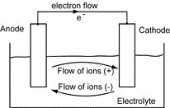
3. Galvanic corrosion
Take place due to the contact between bimetallic couple exposed to the same environment due to the potential difference.
Mechanism of galvanic corrosion:
For two different metals M₁ and M₂ when exposed to the
same corrosive environment, if M₁ is more active than M₂
M₁
M₂

Slide 14
Anodic reaction:
M → M ^{n+} + ne⁻ (n=1, 2, 3, …) Anodic metal will be corroded.
Cathodic reaction:
For strong acidic medium (pH<4)
hydrogen evaluation 2H ⁺ + 2e⁻ → H₂
For neutral or basic medium (pH= 4-10)
1/2 O₂ + H₂O + 2e⁻ → 2OH⁻
-----------------oxygen reduction

Slide 15
Galvanic corrosion type
Dissimilar Metal corrosionتأكل المعادن الغير متماثلة
Differential aeration(oxygenation corrosion)خلايل فرق التهويه تركيز الاوكسجين
Differential stress or strain corrosion تأكل أو خلايا فرق الأجهاد

Slide 16
Dissimilar Metal corrosion
Different metal become in contact in presence of electrolyte
More active metal /less nobel /losses electron (anode) corroded –ve
More nobel less active cathode +ve
Anod/electrolyte/cathode
Cell reaction
Anode –ve
M → M ^{n+} + ne⁻ (n=1, 2, 3, …) Anodic metal will be corroded.

Slide 17
Application on galvanic corrosion
Metal plating
To protect steel tanks (or sheet) we can use Zn, Al, Cu or Pb where zinc and aluminum metal is more active than steel so, they will acts as anode and they will be corroded instead of steel, but copper and lead are less active than steel so, they acts as Cathodic metal and the corroded metal will be the steel tanks.
Zn /electrolyte/ Fe
zn---------zn+2 +2e anode
hydrogen evaluation 2H ⁺ + 2e⁻ → H₂
For neutral or basic medium (pH= 4-10)
1/2 O₂ + H₂O + 2e⁻ → 2OH⁻

Slide 18
Cu, Fe Fe more active than cu so Fe is anode Fe/ electrolyte/cu at anode Fe----------------Fe+ 2e at cathode hydrogen evaluation 2H ⁺ + 2e⁻ → H₂ (pH˂ 4) H For neutral or basic medium (pH= 4-10) 1/2 O₂ + H₂O + 2e⁻ → 2OH⁻

Slide 19
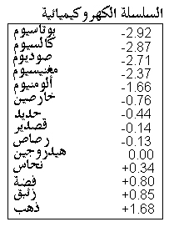
I.e. to protect metal using metallic coating we must use the more active metal.
Zn plating (corroded
Steel tank
Cu plating
Steel tank (corroded)

Slide 20
Welding and rivet process
More active metal | The same metal | Less active metal
(Zn, Mg, Al…) | ( steel) | ( Cu, Pb, Au….)
welding material corroded | --------------- | welded material Corroded
During the steel welding we may use
If use more active metal the welding material will be corroded, but if we use the less active the welded material will be corroded, so the best solution is to use the same metal.

Slide 21
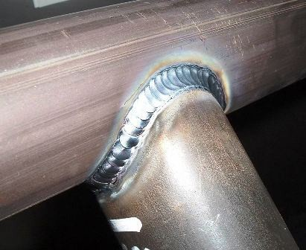
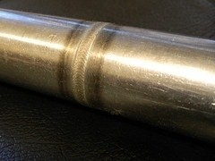
Steel Welding

Slide 22
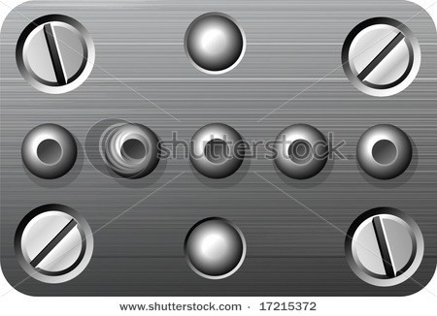
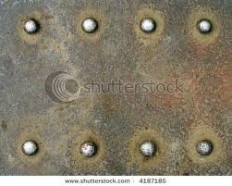
Steel rivet

Slide 23
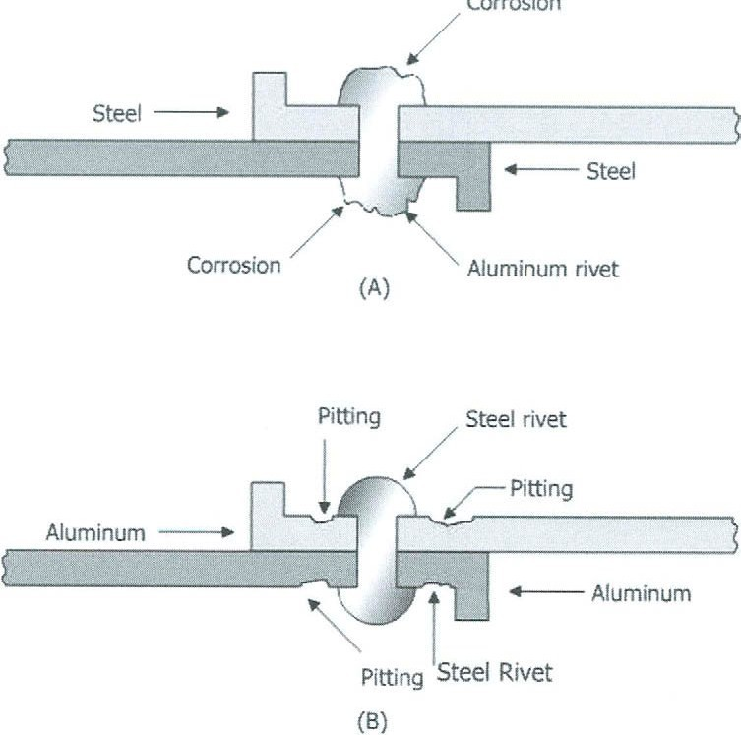

Slide 24
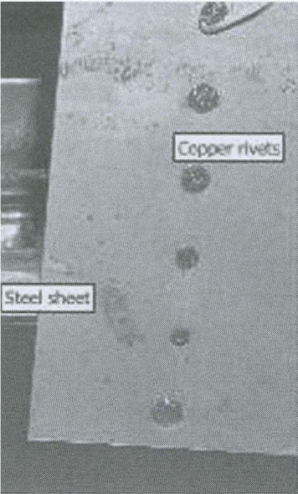

Slide 25
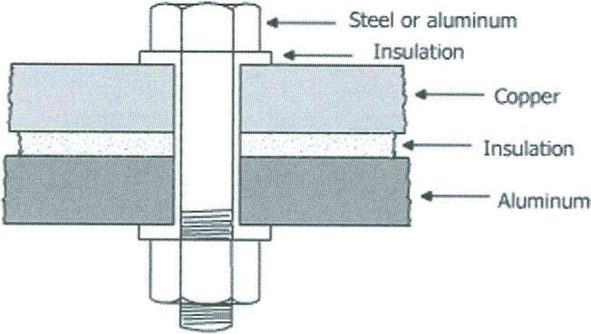

Slide 26
Factors affecting galvanic corrosion state the factor affect on dissimilar metal corrosion
1. Potential Difference (P.D.)
As the P.D increases the galvanic corrosion increase
The rate of corrosion of (Zn/Fe) galvanic cell is slower than corrosion of (Zn/Cu) galvanic cell.
2. Distance
I= V/R
As distance increase as corrosion rate decrease
R= p L/A. L distance between two metals
As distance between two metal L increase R increase and corrosion decrease

Slide 27
3. Area(ratio of cathodic area to anodic area
As the Area (C/A)ratio increases the galvanic corrosion
increase.
As the Area (C/A)ratio decreases the galvanic corrosion decrease.

Slide 28
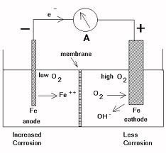
Differential Aeration Cell
This type of corrosion takes place due to the differential in oxygen concentration on the same metal or alloy.

Slide 29
Porous barrier allow the transfer of ions only
through it, so oxygen gas will not penetrate the porous membrane.
Metal (poor O₂) // electrolyte // Metal (rich O₂)
Anode (+) Cathode (-) Corroded Area
Oxygen بيحفز الreduction occure in cathode mean gain electron لذلك يحفز المعدن للتأكل

Slide 30
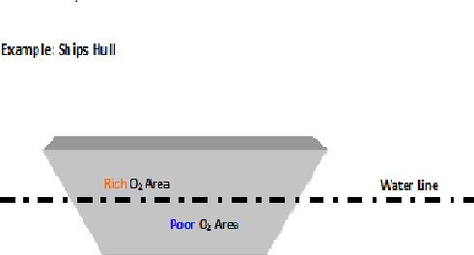
Corrosion of ship hull

Slide 31
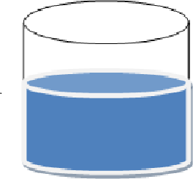
Corrosion of water tanks
Rich oxygen
Corroded area Poor oxygen
3. Differential Stress Corrosion

Slide 32
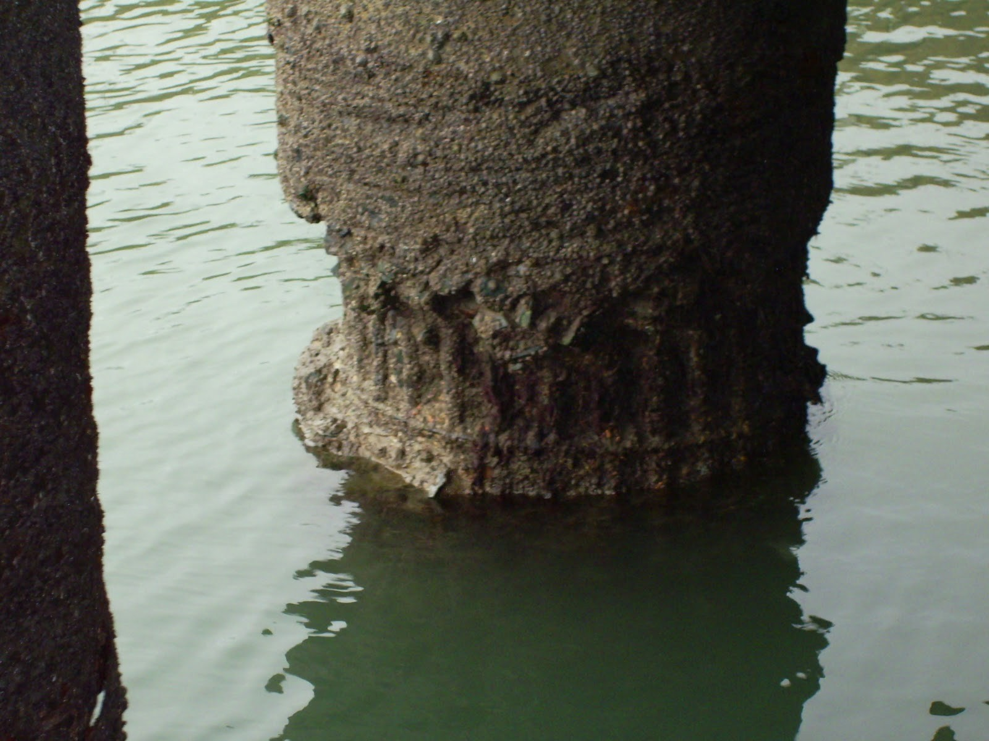

Slide 33
3. Differential stress corrosion
Take place when the surface is strained to different degree
Strained part is anode
Less strained part is cathod
Cell reaction
Anodic reaction:
M → M ^{n+} + ne⁻ (n=1, 2, 3, …) Anodic metal will be corroded.
Cathodic reaction:
For strong acidic medium (pH<4)
hydrogen evaluation 2H ⁺ + 2e⁻ → H₂
For neutral or basic medium (pH= 4-10)
1/2 O₂ + H₂O + 2e⁻ → 2OH⁻
-----------------oxygen reduction

Slide 35
4.Stress corrosion cracking (S.C.C)
This type of corrosion takes place due to presence of stress on the metal surface and specific corrosive environment.
Stress = force / cross sectional area
Any metal undergo stress corrosion cracking it must be under stress and in specific corrosive environment.
تأكل الشكوك الأساس فيه ال stress and specified type of electrolyte

Slide 36
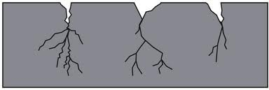

Slide 37
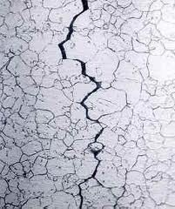

Slide 38
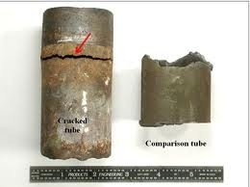

Slide 39
Examples
Stressed steel + nitrate or hydroxide ion tends to S.C.C
Stressed copper and it's alloy + ammonia tends to S.C.C
Stressed stainless steel + chloride ion tends to S.C.C
Alumina ----sea water and water vapor
Stress CC localized at stressed area
Not gradually

Slide 40
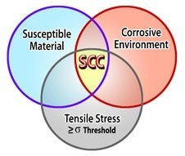

Slide 41
Mechanism of stress corrosion cracking:
S.C.C starts as pitting corrosion.
At the tip:
Very concentrated stress. Very concentrated corrosion.

Slide 42
Factors affecting S.C.C:
Specific environment
Stress magnitude and direction.
Structure and metal composition.

Slide 43
Compare between SCC and DSC
SCC DSC
Take place with certain corrosion - take place with any corrosion
Localized - un localized
Sudden failure - gradually Faliure
It must be cyclic inspection - it appear on the
surface
-by decreasing the
thickness

Slide 44
5.Pitting Corrosion تأكل النقر
In this type, corrosion is concentrated at some places and is less in others, thus pits are formed.
It’s a form of localized corrosion attack in which small pits or holes form.

Slide 45
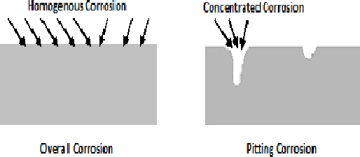
Over all and pitting corrosion

Slide 46
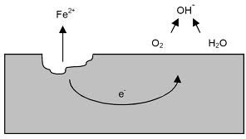

Slide 47
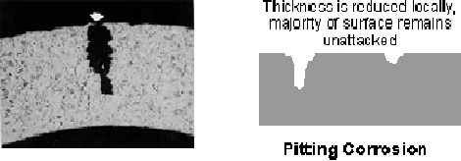

Slide 48
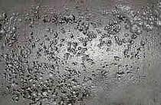
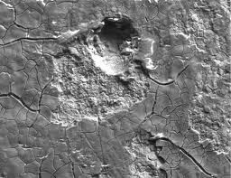

Slide 49
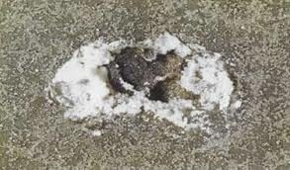
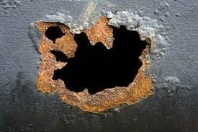

Slide 50
Reasons of Pitting Corrosion
The Non-homogeneity of metal surface
Due to the presence of impurities at the metal surface. عدم تجانس سطح المعدن
Example :such as manganese oxide (MgO) or ferrous sulfide(feS) on steel alloy.
So we make grinding and polishing
. Non homogeneity of environment

Slide 51
Reasons of Pitting Corrosion
The Non-homogeneity of external environment
Due to the presence of different areas in concentration or presence of concentrated acids.
Example: dew point on steel surface make two different areas in oxygen concentration, acidic rain on steel surface tends to pitting corrosion

Slide 52
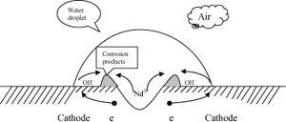

Slide 53
Reasons of Pitting Corrosion
Corrosion products may be insoluble
due to formation of insoluble corrosion products like ferrous sulfide (FeS) which formed by combination between corrosion products (ferrous ion) and sulfide ion from air on steel surface tends pitting corrosion (petroleum production area).

Slide 54
Reasons of Pitting Corrosion
Oxide Layer in not uniformly perfect
Due to the oxide layer may be broken in a small area
Example: Effect of chloride ions on stainless steel alloy exposed to salt water tends to pitting corrosion of chromium content reduced less than12%.
this appear with stainless steel pumps used with salt water, after shut down the pump for few days, pitting corrosion greatly developed.

Slide 55
Factors affecting pitting corrosion
Velocity
as velocity of fluid increase, electrolyte solution become homogeneous, and hence pitting corrosion decrease and over all corrosion rate increase.
as velocity of fluid decrease, electrolyte solution become non homogeneous, and hence pitting corrosion increase.
السرعه العاليه تقلل ال pitting corrosion

Slide 56
Factors affecting pitting corrosion
Acidity (PH- value الرقم الهيدروجيني )
as PH decrease, medium become more acidic which help in removal of impurities , corrosion products, dew and oxide layer ,Hence pitting corrosion decrease and over all corrosion rate increase.
as PH increase, acidity decrease and pitting corrosion will increase .

Slide 57
6.Erosion corrosion تأكل البري
It is a combination between corrosion and mechanical wear on the metal surface.
Erosion take place due to mechanical wear on metal surface
Corrosion takes place due to chemical or electrochemical reactions.
تمثال الحريه من النحاس تكونت عليه طبقة أوكسيد غيرت لونه نتيجة الرياح وهذه الطبقة تعتبر طبقة حمايه من الوسط المحيط
وبعد ذلك اتت موجة رياح سريعة جدااا ادت اي أزالة طبقة الاكسيد ويتاكسد مرة أخري ويقل وزنه
Erosion corrosion

Slide 58
Erosion corrosion depends on
Metal surface (hardness of surface)
Soft metal | Hard metal
Pb, Cu, Ag | Cr, high carbon steel
Soft metals are more sensitive to erosion corrosion.
Environmental condition.

Slide 59
Factors affecting erosion corrosion
High degree of turbulent:
Turbulent is formed due to high velocity of velocity of fluid and sudden change in direction of the fluid.
As turbulent increase as mechanical wear increase and hence the erosion will increase. in order to decrease the turbulence effect , the
thickness of tube or pipe in the turbulence area must be increased.

Slide 61
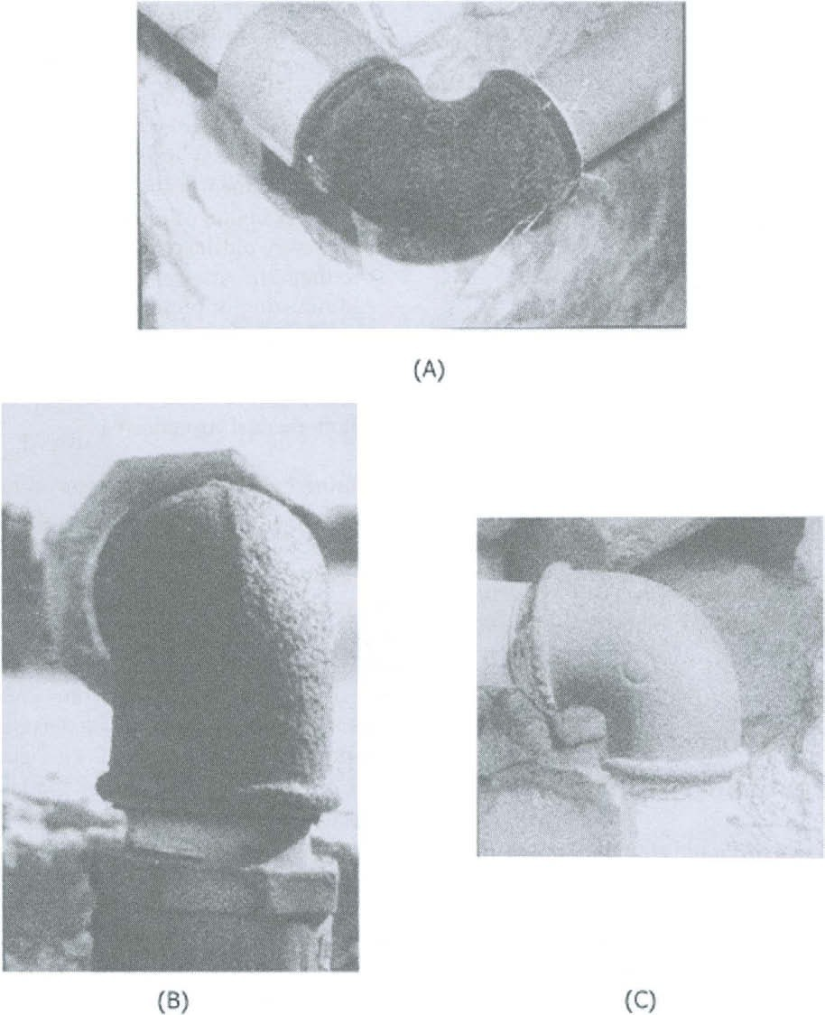

Slide 62
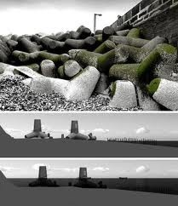

Slide 63
Factors affecting erosion corrosion
Presence of solid or suspended materials:
As suspended or solid material increase as the mechanical wear increase and hence erosion increase

Slide 64
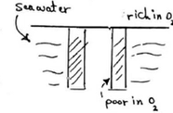
EX: Stanly bridge of relative humidity more than 60%
What is the type of cells corrosion
1)RH˃ 60% atmospheric corrosion
2) Erosion corrosion (erosion as a result to the motion of wave and corrosion as a result to the presence to Nacl)
3) At the interface there's differential aeration corrosion
Poor oxygen /electrolyte /rich oxygen

Slide 65
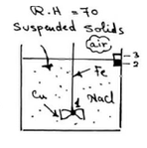
EX: Cylindrical tank made from ferrous metal and exposed to air of relative humidity 70% has a ferrous mixer end with copper fan. The tank has suspended solid .
What is the type of cells corrosion
Rh more than 60% atmospheric corrosion
At point 1 dissimilar metal corrosion
Fe/electrolyte/fe3C
Erosion corrosion the presence of solids impact with ferrous
Differential aeration corrosion
As there's separated surface so there's poor and rich region of oxygen
Fe (poor oxygen) /electrolyte / Fe (rich oxygen)

Slide 66
Tank rom steel and pipe from cupper with valve from alluminum with relative humidity 70
At point 1 Dissimilar metal corrosion fe/ele/cu
At point 2,3,4,5 dissilmilar Al/ele/cu
At interface differential aeration corrosion

